Slide 1
Computing in Renewable Energy Technology
Presentation

Slide 2
Plan of the presentation
Introduction
Main body:
1) Wind Energy
2) Solar Power
3)
Conclusion

Slide 3
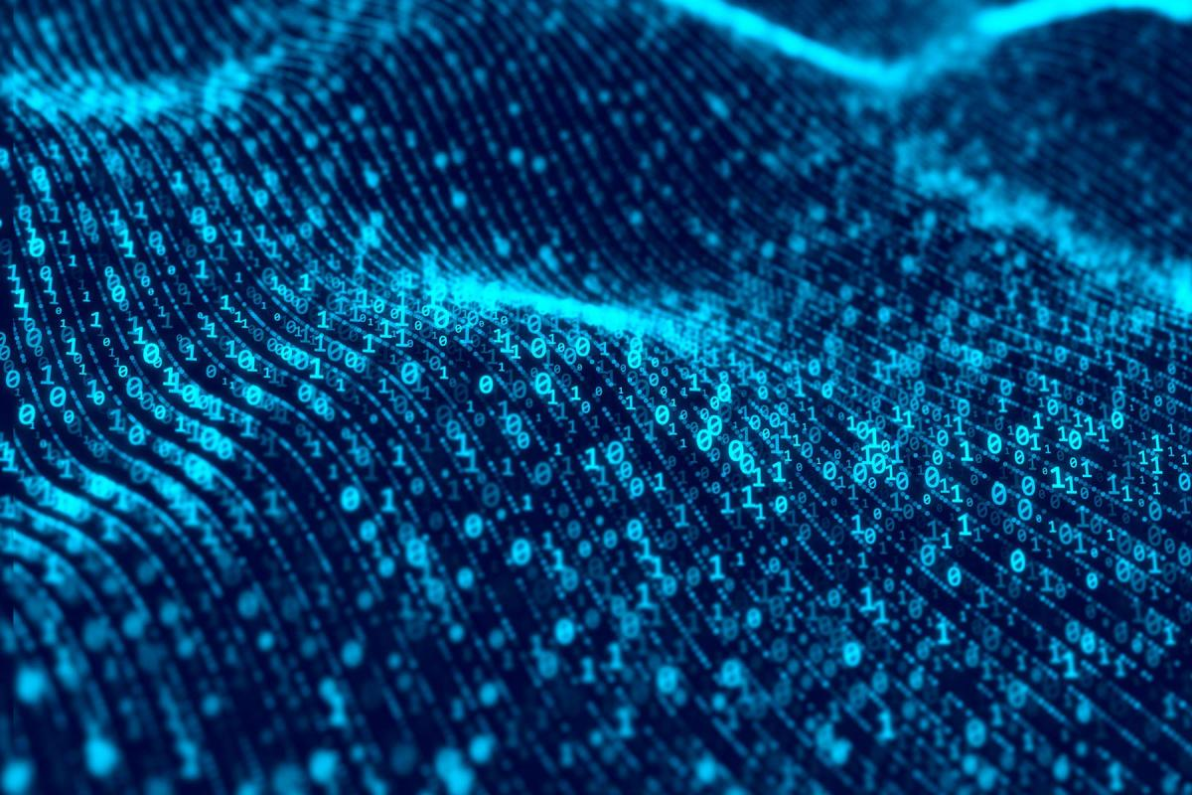
Introduction
Computing - the use or operation of computers. Includes designing, developing and building hardware and software systems, processing, structuring, and managing various kinds of information.

Slide 4
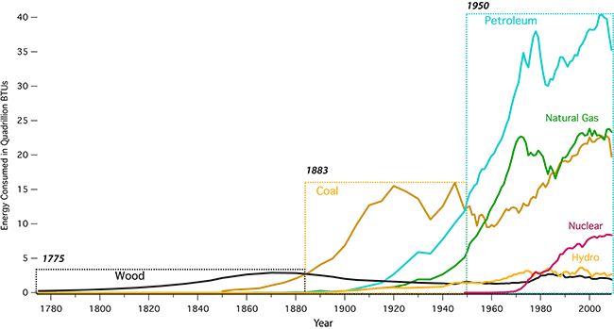
Introduction

Slide 5
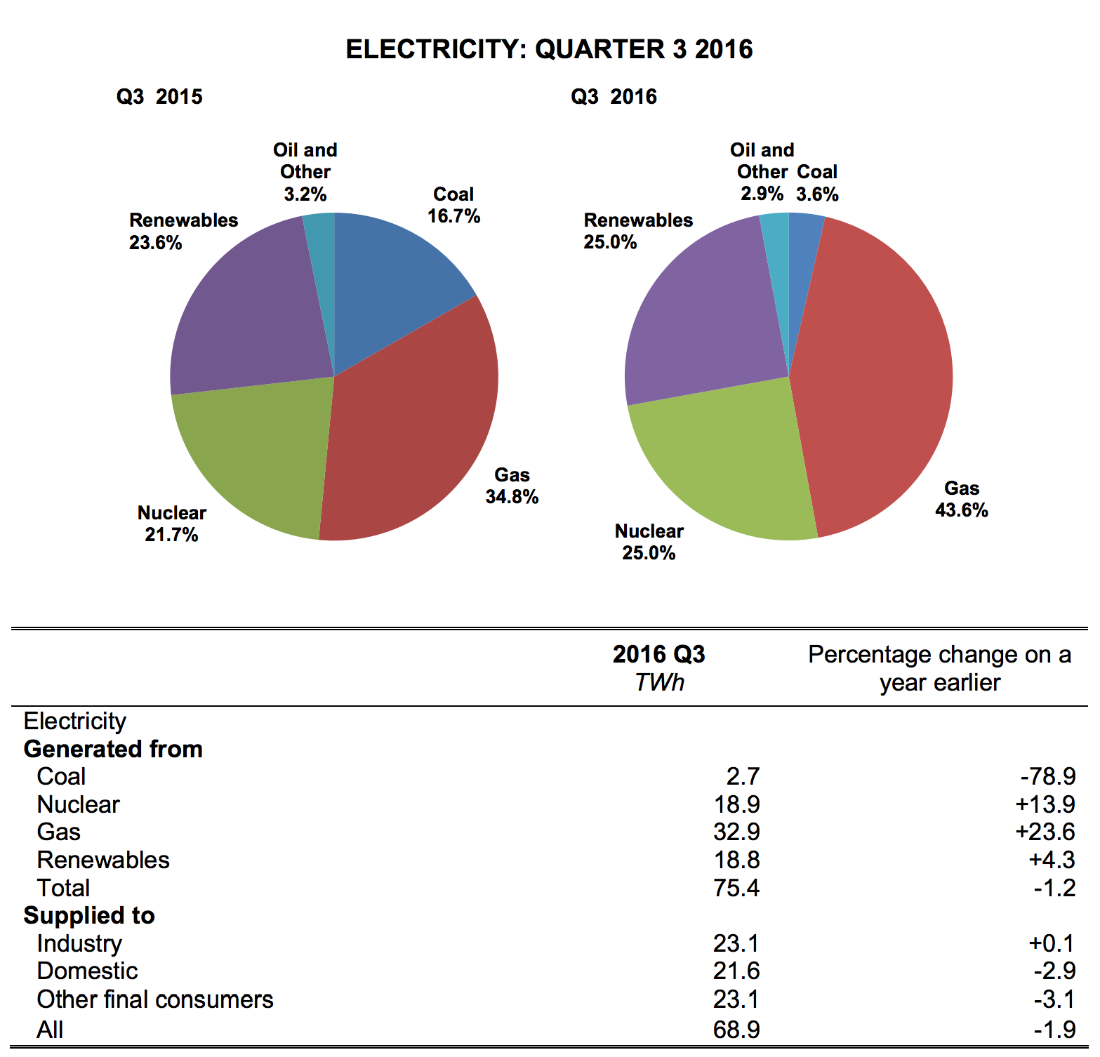
Wind Energy
Used as early as 5000 years B.C. in Egypt fishing boats
1970’s as a replacement to depletable energy sources

Slide 6
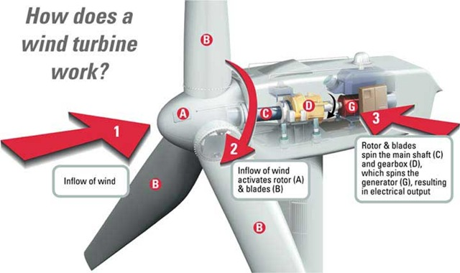
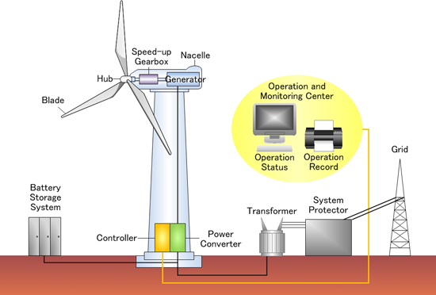
Wind Energy

Slide 7
Wind Energy
Computer’s tasks:
Direction of blades and rotor
Operation status and record
Grid status and availability
Monitoring of battery storage system
Locations:
Near the shores or hills, as off-shore platforms cost a lot more.

Slide 8
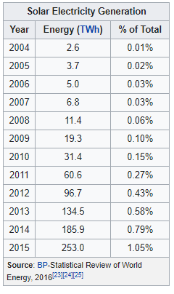
Solar Power
Residential solar panels can be based in any sunny location such as roof.
Experienced several growth and stagnation periods during 20th century due to inconsistent coal and oil prices.
Biggest growth was from 2010 to 2017 resulting in 31x as much energy produced in 2017 than in 2010.

Slide 9
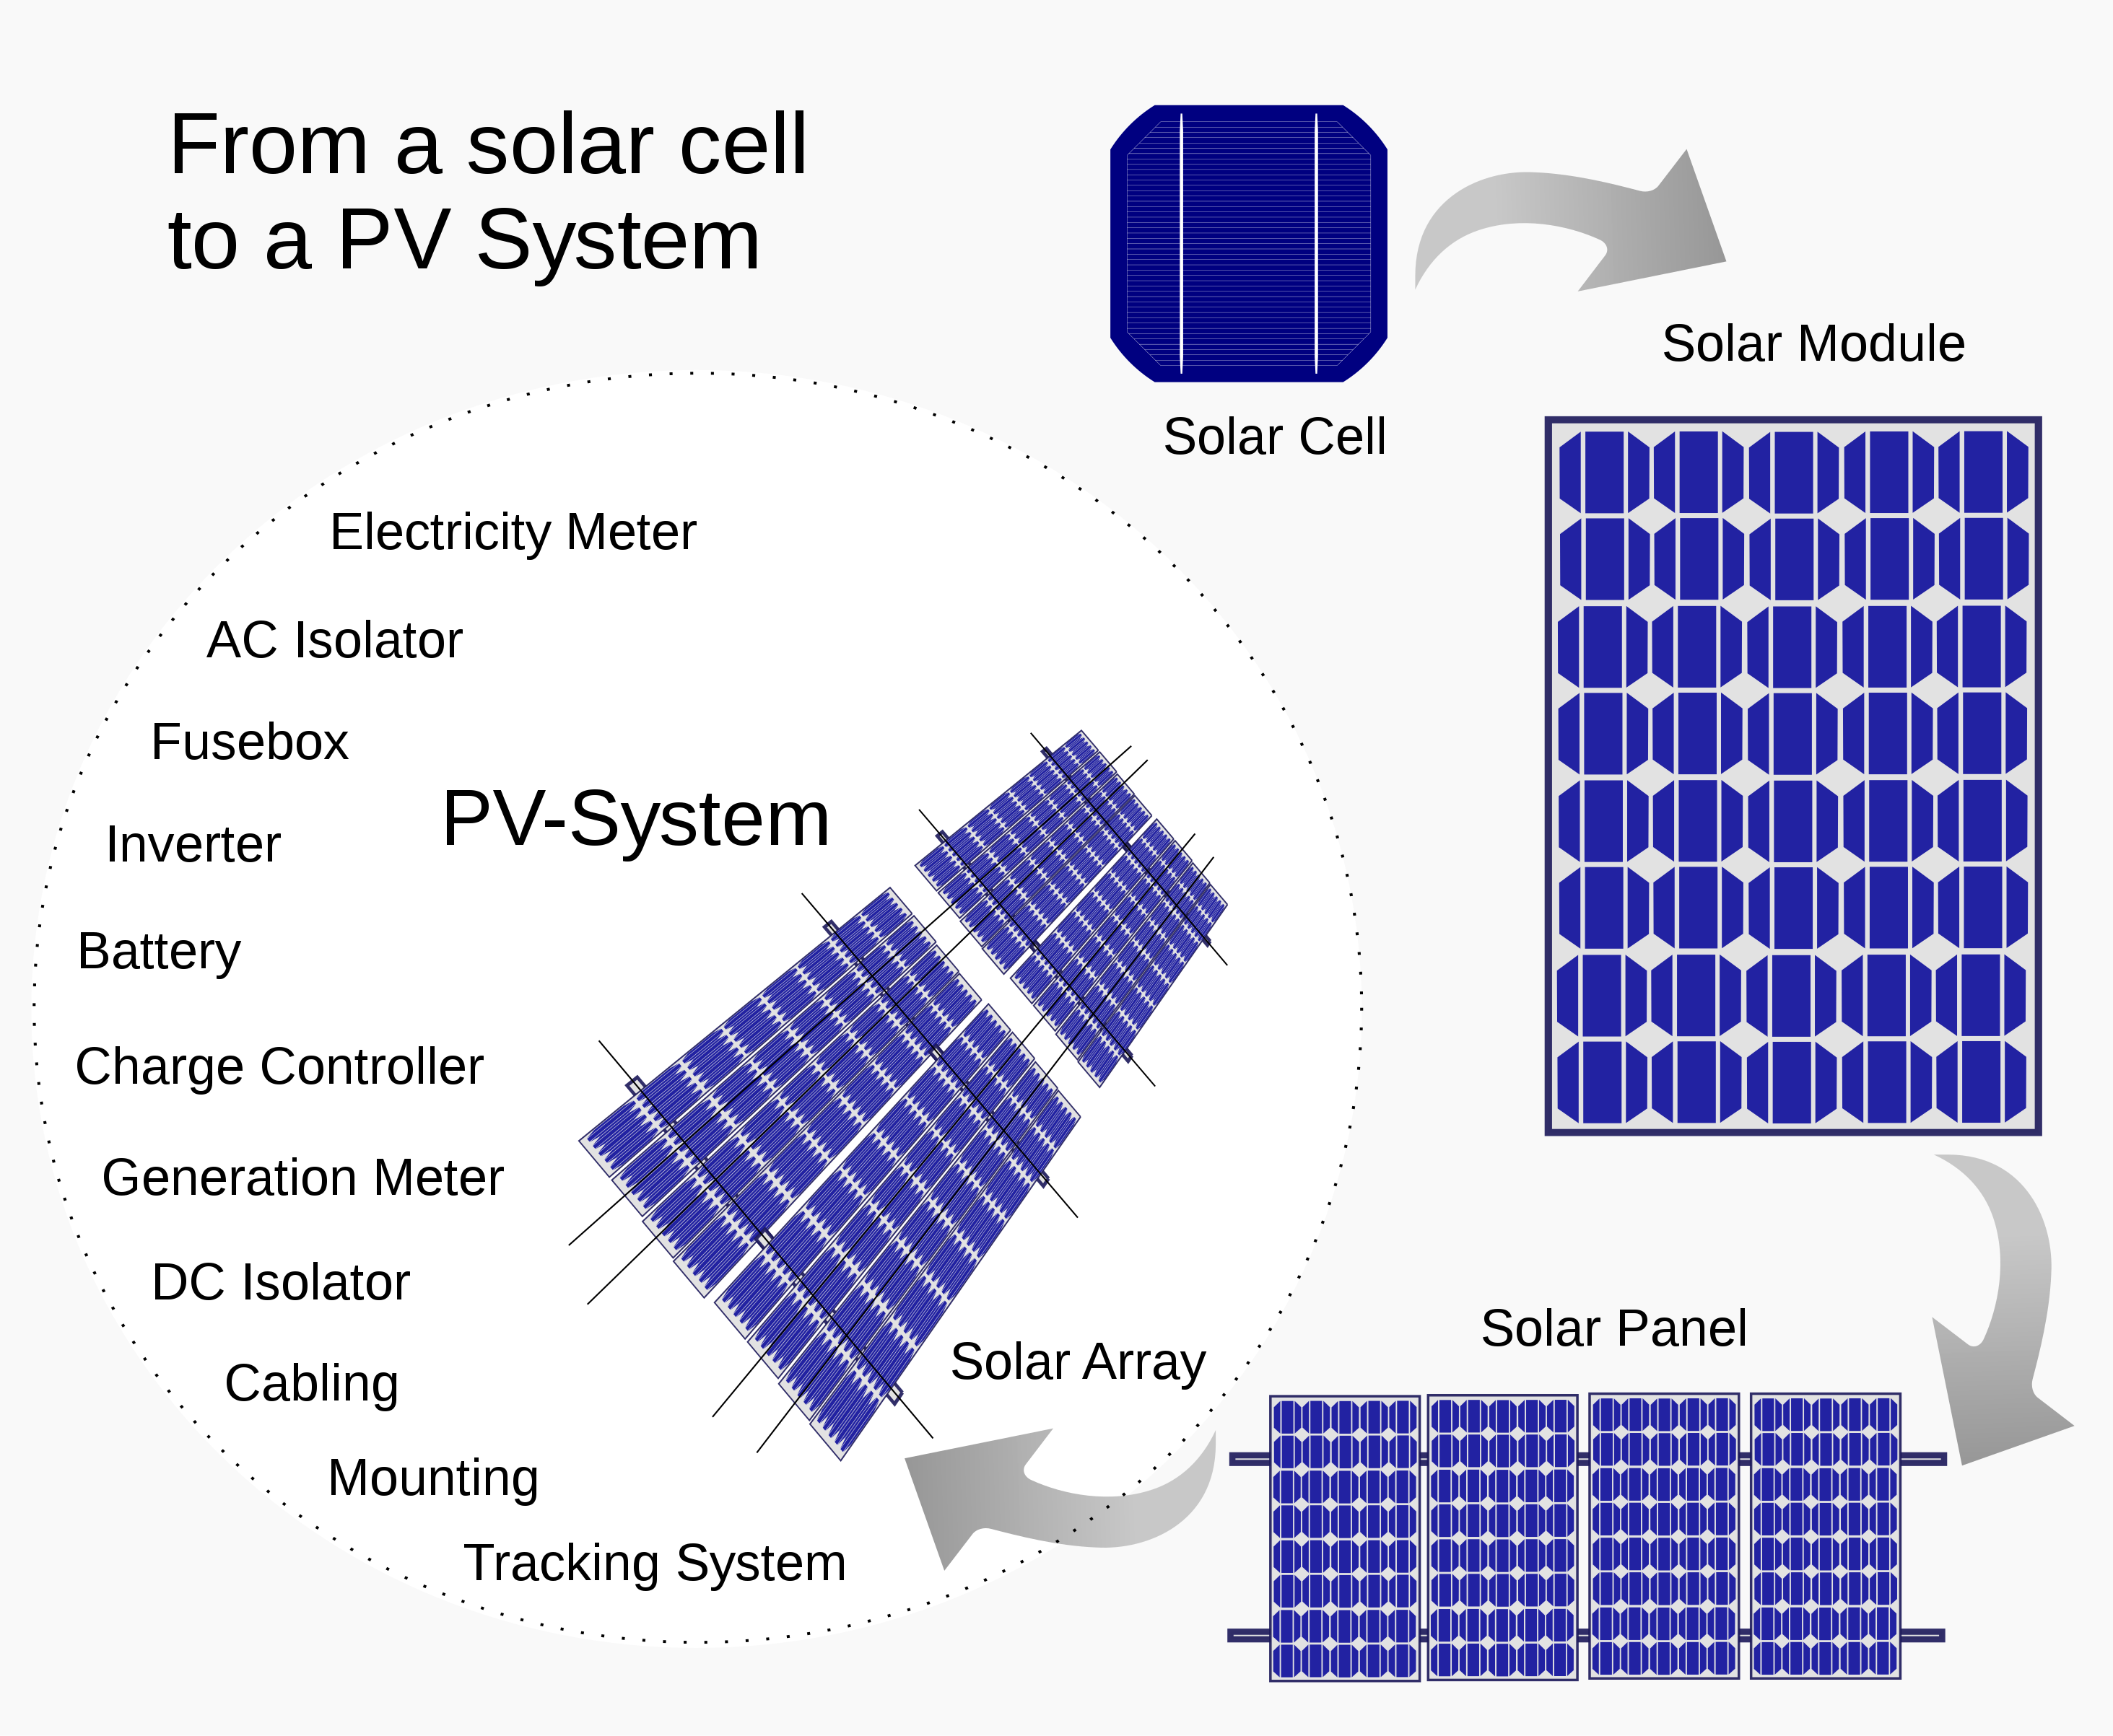
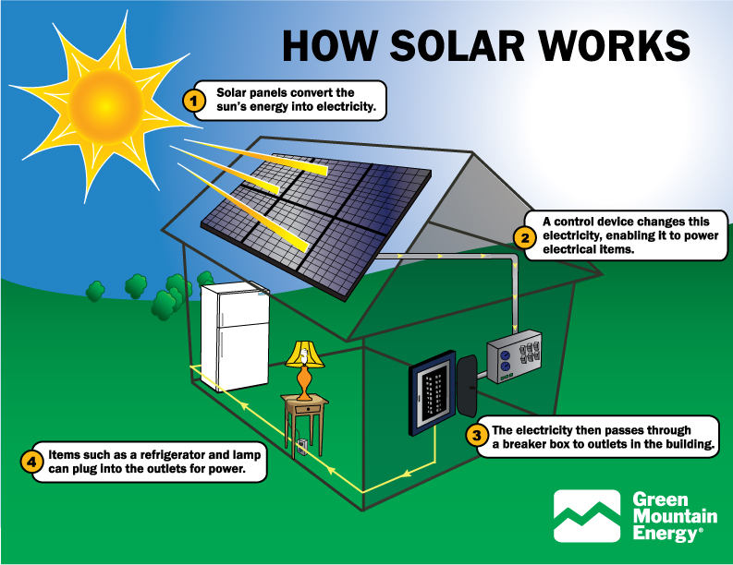
Solar Power

Slide 10
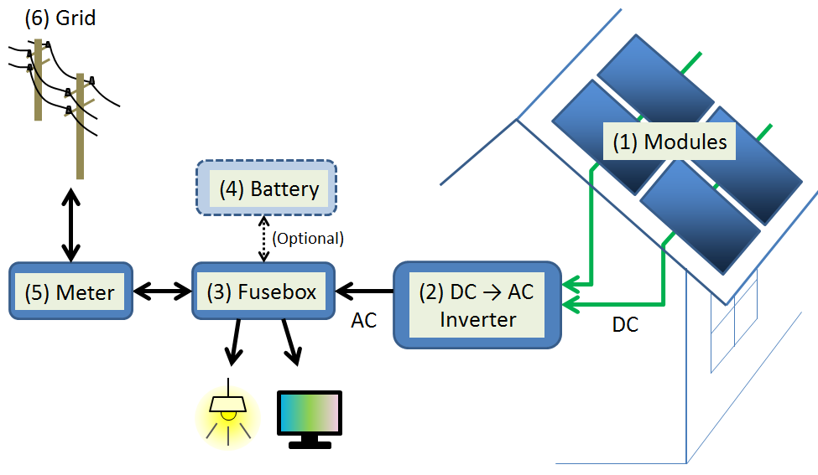
Solar Power
Computer’s tasks:
Adjusting the panels and facing them to the sun, to cover as much area as possible
Battery management and availability
Grid status and availability
Charge and current control
Locations (for commercial photovoltaic systems):
Deserts, Mountains and other high, sunny areas.

Slide 11
Conclusion

Slide 12
List of sources
https://en.wikipedia.org/wiki/Green_computing
https://en.wikipedia.org/wiki/Computing
https://en.wikipedia.org/wiki/Solar_power
Green Illusions: The Dirty Secrets of Clean Energy and the Future of Environmentalism, book by Ozzie Zehner
https://energy.gov/

Slide 13

The End
Presentation made by Tadas Laurinaitis
Presented by Tadas Laurinaitis IFF – 6/8

